Slide 1

NIGHT ROUND

Slide 2
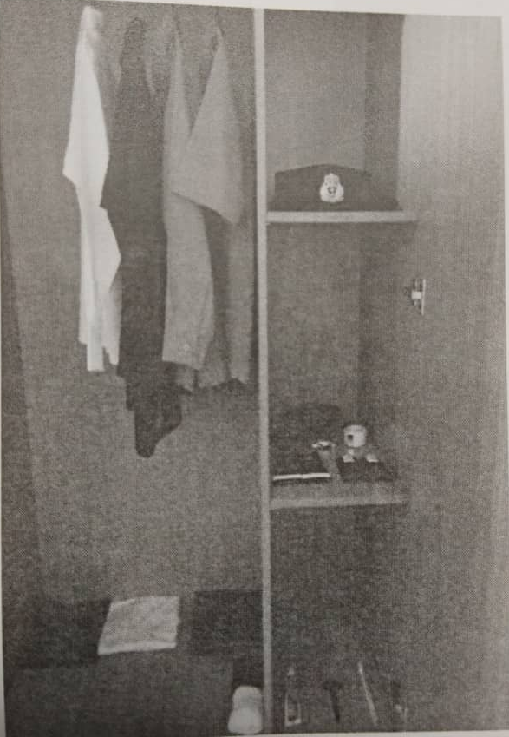
LOCKER’S LAYOUT (ALPHA ROUTINE)

Slide 3
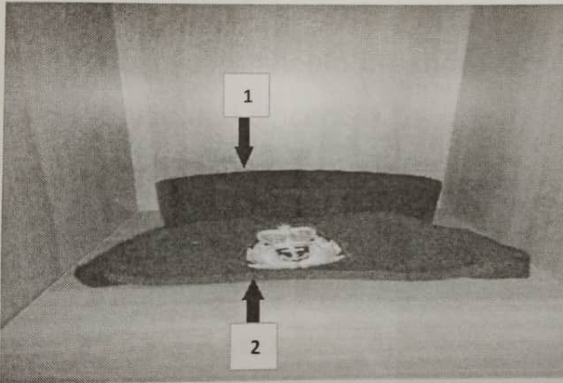
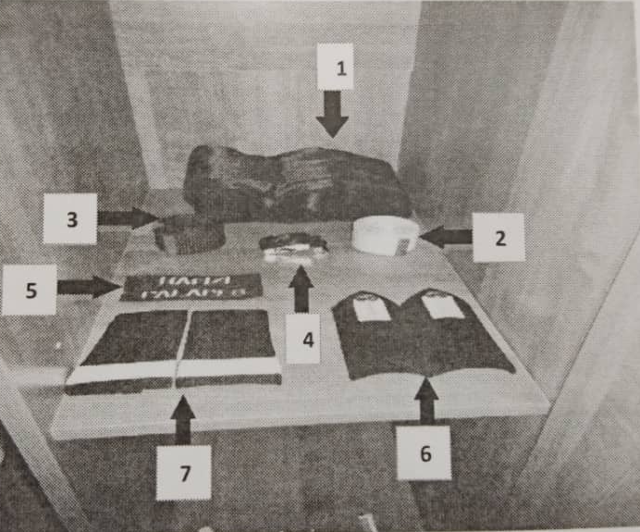
1.SONGKOK 2.BERET
1.BENGKONG
2.BELT PUTIH
3.BELT HITAM
4.BUCKLE
5.NAME TAG/VELCRO
6.EPAULETTE
7.SLIP ON

Slide 4
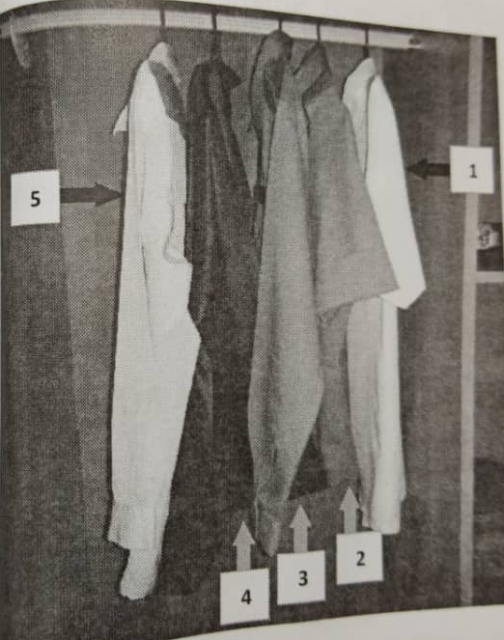
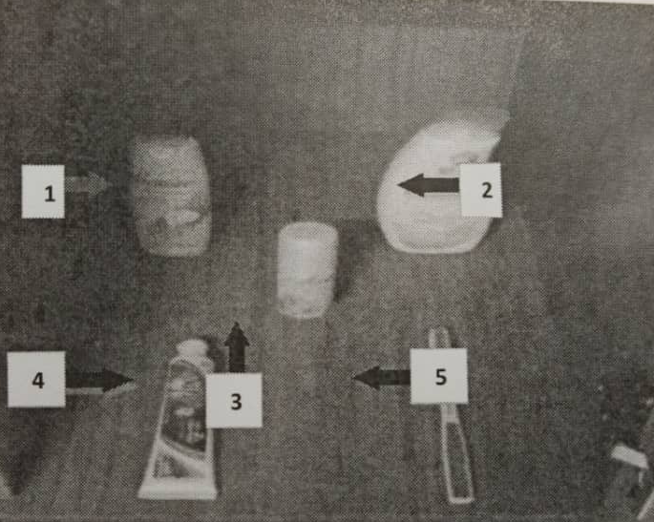
1.SYAMPU 2.SABUN MANDI 3.DEODORAN 4.UBAT GIGI 5.BERUS GIGI
1. 2A
4. MUFTI RIG
5.WHITE PLANTERS

Slide 5
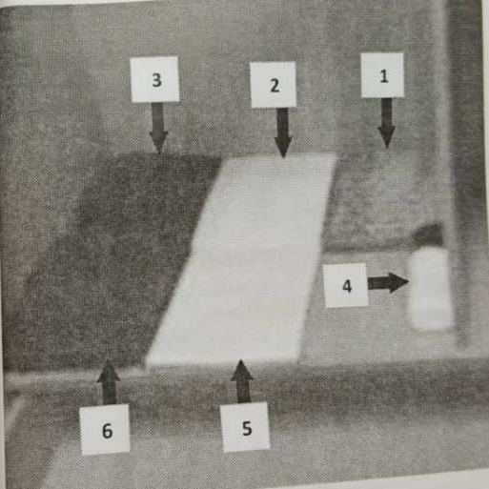
1. SAMPIN 2. WHITE T-SHIRT 3. BLUEBACK TRACK SUIT 4.BLACK SOCK,WHITE SOCK 5.WHITE SINGLET 6.SLACK TROUSERS (SHIRT ARRANGE FROM UPPER RIGHT SIDE WITH THE SIZE SQUARE 8INCH x 10INCH)

Slide 6
KETUA BLOK
1- SALUTE (1,2,3...1)
SALAM, ALL CABIN, PASSAGEWAY, HEAD READY FOR NIGHT ROUND SIR/MAAM.
2-SALUTE (1,2,3...1)
KETUA BILIK
1-SALUTE (1,2,3...1)
SALAM, SEBUT NO BILIK (Room No.1), READY FOR NIGHT ROUND SIR/MAAM.
2-SALUTE (1,2,3...1)
KELUAR (KETUA BLOK)
1-SALUTE (1,2,3...1)
NIGHT ROUND COMPLETED,REQUEST PERMISSION TO CARRY ON SIR/MAAM.
2-SALUTE (1,2,3...1).
SEQUENCES
NIGHT ROUND

Slide 7
PLACE THAT NEED
TO CLEAN
ALL PART INSIDE ROOM AND OUTSIDE ROOM
- PARKING CAR
- RAK KASUT
- PINTU
- TINGKAP
- LANGSIR
- KIPAS
- LOKER
- KATIL
- CADAR
- TANDAS

Slide 8
MESS ETIQUE

Slide 9
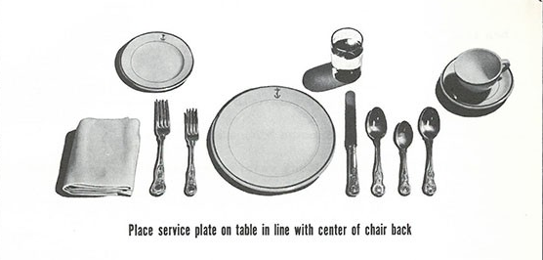
POSITION
GLASS
FORK
SPOON
PLATE
KNIVE

Slide 10
SEQUENCE ENTERING MESS
CADETS MUSTER OUTSIDE MESS
KETUK (3X)
(OC) ASSALAMUALAIKUM, SIR/MAAM.
(OC) EXCUSE OUR RIG, SIR/MAAM.
(OC) ON BEHALF OFFICER UNDER TRAINING REQUEST PERMISSION TO ENTER THE MESS, SIR/MAAM.
(OC) (AFTER BEING EXCUSED) LADIES AND GENTLEMAN, EXCUSE ME SIR/MAAM, YOU MAY ENTER THE MESS NOW.
(ALL) THANK YOU, SIR/MAAM.
(ALL) EXCUSE ME, SIR/MAAM.
BEFORE ENTERING THE MESS

Slide 11
SEQUENCE ENTERING MESS
PERMISSION
TO HAVE
A SEAT
CADETS STAND BEHIND THEIR CHAIR
(OC) MESS QUIET PLEASE!!!
(OC) EXCUSE ME, SIR/MAAM.
(OC) ON BEHALF OFFICER UNDER TRAINING REQUEST PERMISSION TO HAVE OUR SEAT, SIR/MAAM.
(OC) (AFTER BEING EXCUSED) LADIES AND GENTLEMAN, EXCUSE ME SIR/MAAM, YOU MAY HAVE YOUR SEAT NOW.
(ALL) THANK YOU, SIR/MAAM.
(ALL) EXCUSE ME, SIR/MAAM.

Slide 12
SEQUENCE ENTERING MESS
CADETS SEAT ON THEIR CHAIR
(OC) EXCUSE ME, SIR/MAAM.
(OC) REQUEST PERMISSION TO RECITE THE PRAYER AND HAVE OUR LUNCH/DINNER, SIR/MAAM.
(OC) (AFTER BEING EXCUSED) OFFICER CADET (NAME), RECITE THE PRAYER PLEASE.
(NAME) (PRAYER TRANSLATION) “In the name of ALLAH, thanks for giving us foods and drinks and protect us from sins and hell fire.”
(OC) (AFTER RECITAL) LADIES AND GENTLEMAN, EXCUSE ME SIR/MAAM, YOU MAY HAVE YOUR LUNCH/DINNER NOW.
(ALL) THANK YOU, SIR/MAAM.
(ALL) EXCUSE ME, SIR/MAAM.
PERMISSION TO HAVE LUNCH/
DINNER

Slide 13
SEQUENCE ENTERING MESS
PERMISSION
TO
CARRY ON
CADETS HAVE FINISHED THEIR MEALS
(OC) MESS QUIET PLEASE!!! EXCUSE ME, SIR/MAAM.
(OC) ON COMPLETION OF OUR LUNCH/DINNER, REQUEST PERMISSION TO RECITE THE PRAYER AND CARRY ON, SIR/MAAM.
(OC) (AFTER BEING EXCUSED) OFFICER CADET (NAME), RECITE THE PRAYER PLEASE.
(NAME) (PRAYER TRANSLATION) “In the name of ALLAH, thanks for giving us foods and drinks and place us among good Muslims.”
(OC) (AFTER RECITAL) LADIES AND GENTLEMAN, EXCUSE ME SIR/MAAM, YOU MAY CARRY ON NOW. MESS CARRY ON PLEASE!!!
(ALL) THANK YOU, SIR/MAAM.
(ALL) EXCUSE ME, SIR/MAAM.

Slide 14
THE END (THANK YOU)

